Slide 1
Automation of IT Service Management at Johnson & Johnson
Jairo Melo
ML1030 Capstone Course
Dr. Harish Bhaskar
MLCapstone Course - September 9, 2019

Slide 2
Agenda
The Problem
Motivation
The Final Goal
Benefits
Model Creation Process
Data Set
Data Preparation and Analysis
Results
Deployment + Demo
Conclusions

Slide 3
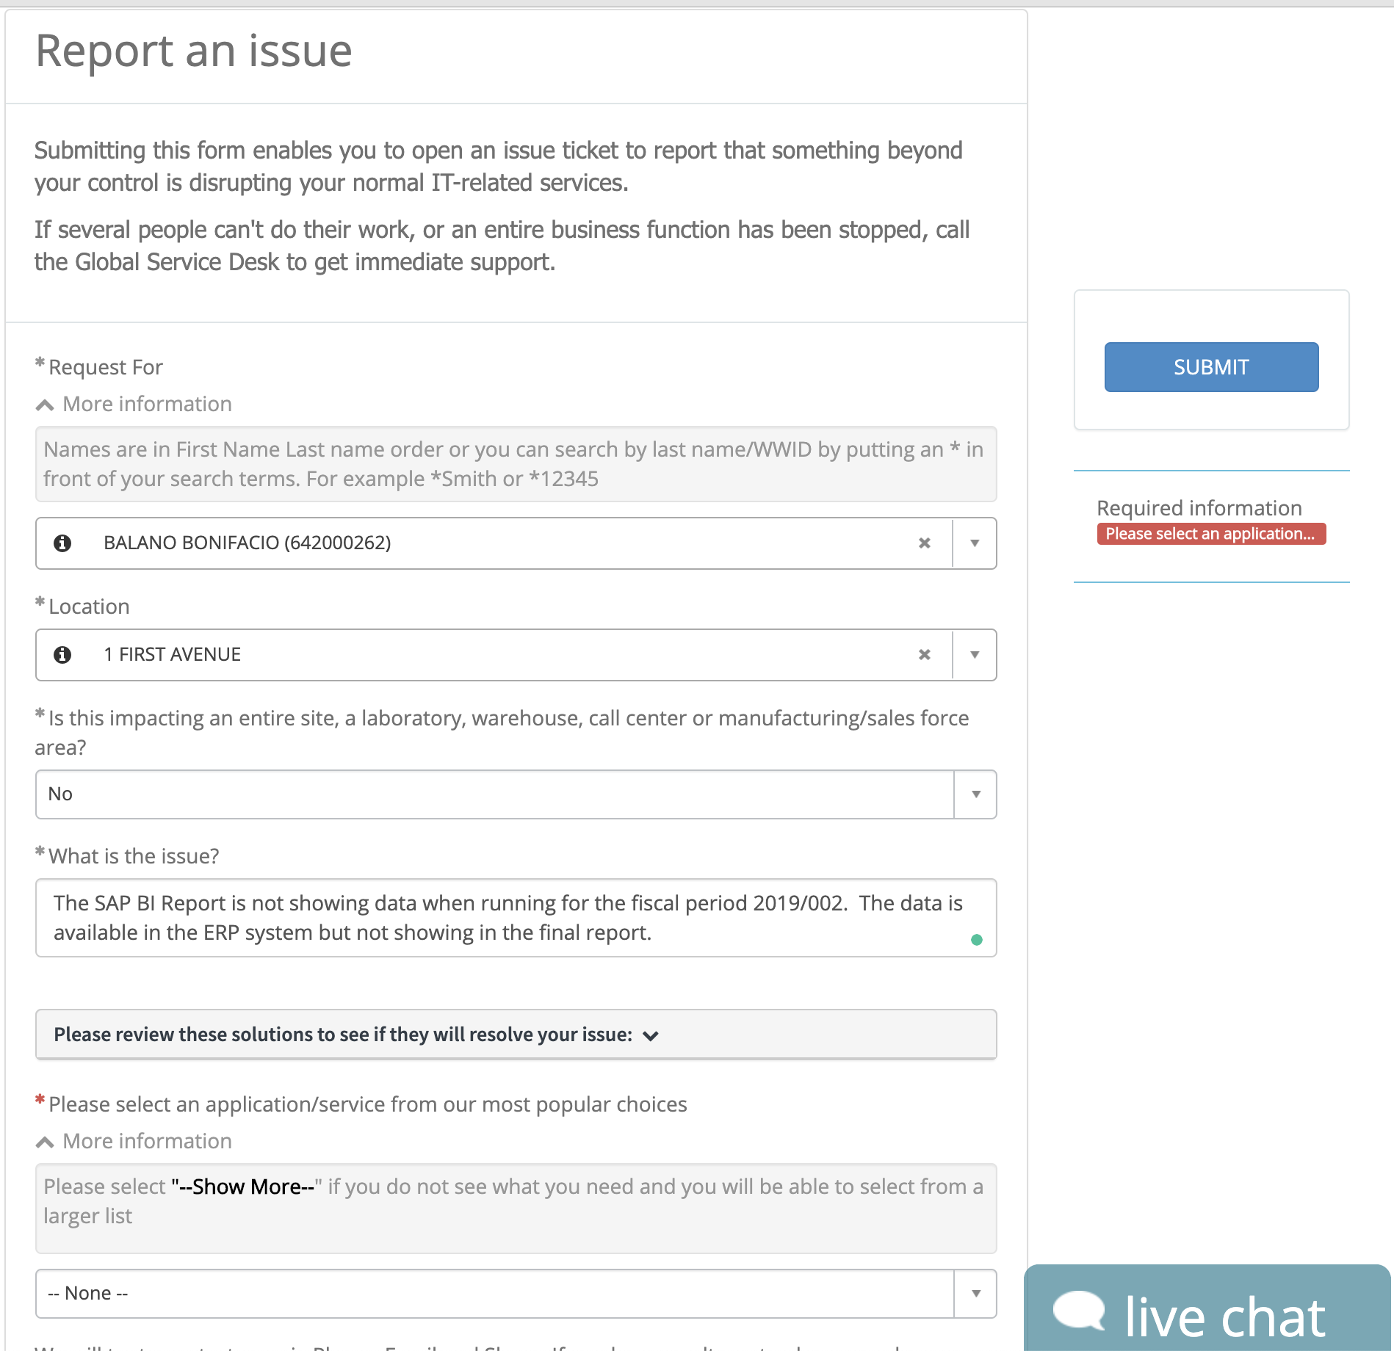






The Problem
Almost 10–15% of incident tickets are not routed to the right team
Tickets created with “false” low priority causing multiple escalations
The MTTR is high as the resolution is not identified promptly causing business impact and exhausting resources

Slide 4
Motivation
What is ITSM?
IT Service Management (ITSM) is a process-based practice intended to align the delivery of information technology (IT) services with needs of the organization, emphasizing benefits to customers. ITSM involves a paradigm shift from managing IT as stacks of individual components to focusing on the delivery of end-to-end services using best practice process models.
Objective
Prototype a ML-based process automation to associate the reported issue to previous incidents and predict a solution referring to the fields used to log the resolution of the incident. This prediction will be used by ServiceDesk to determine the best course of action including Support team and criticality.

Slide 5
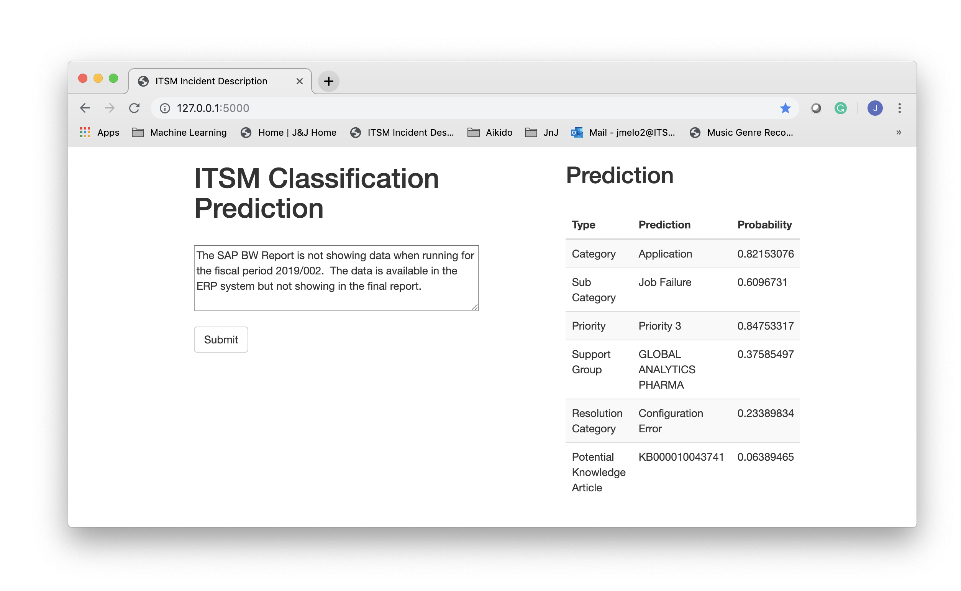
The final goal

Slide 6
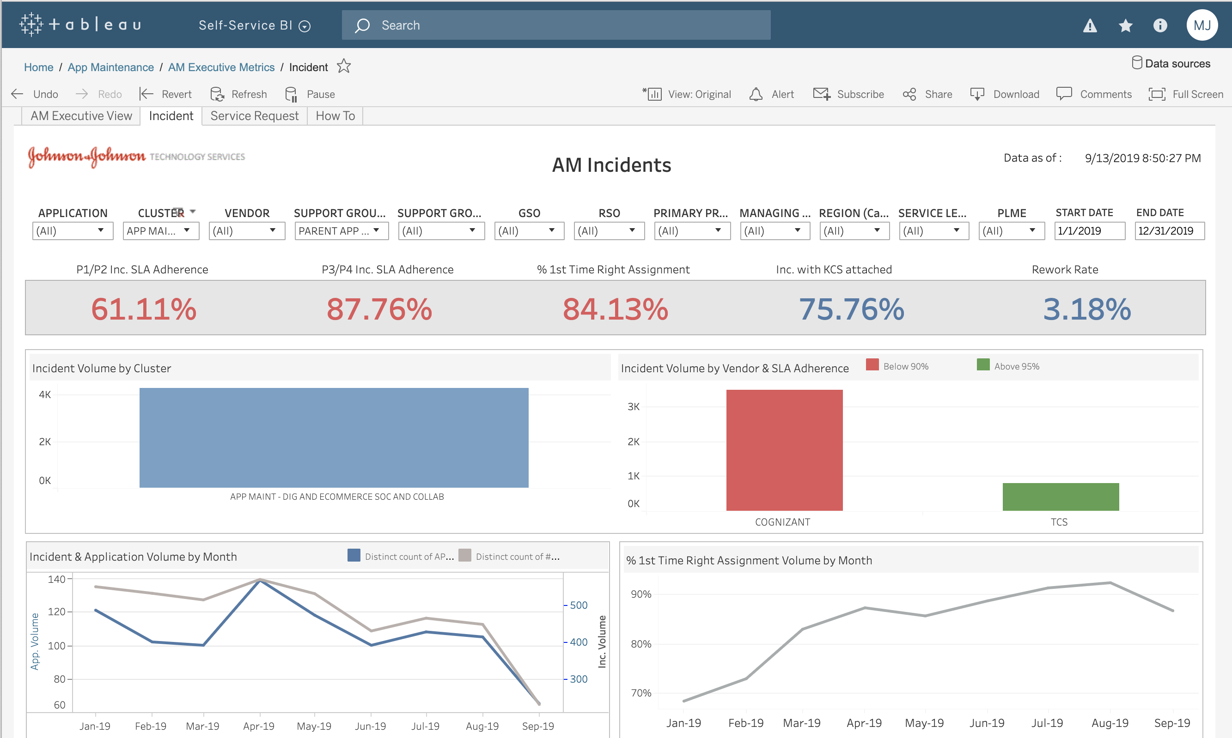
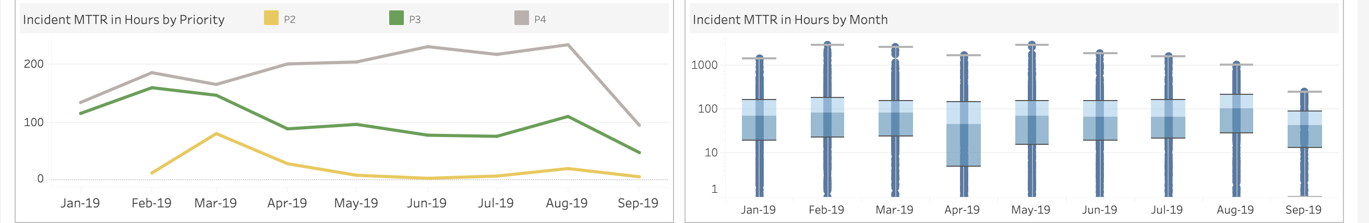
Benefits
Increase first time right assignment 90%
Increase SLA% over 95%
Reduce MTTR to 10-50hrs
Increase visibility of Ticket resolution
Uncover hiden connexions of the incidents
Speed-up RCA resolution
Better use of current human resources

Slide 7
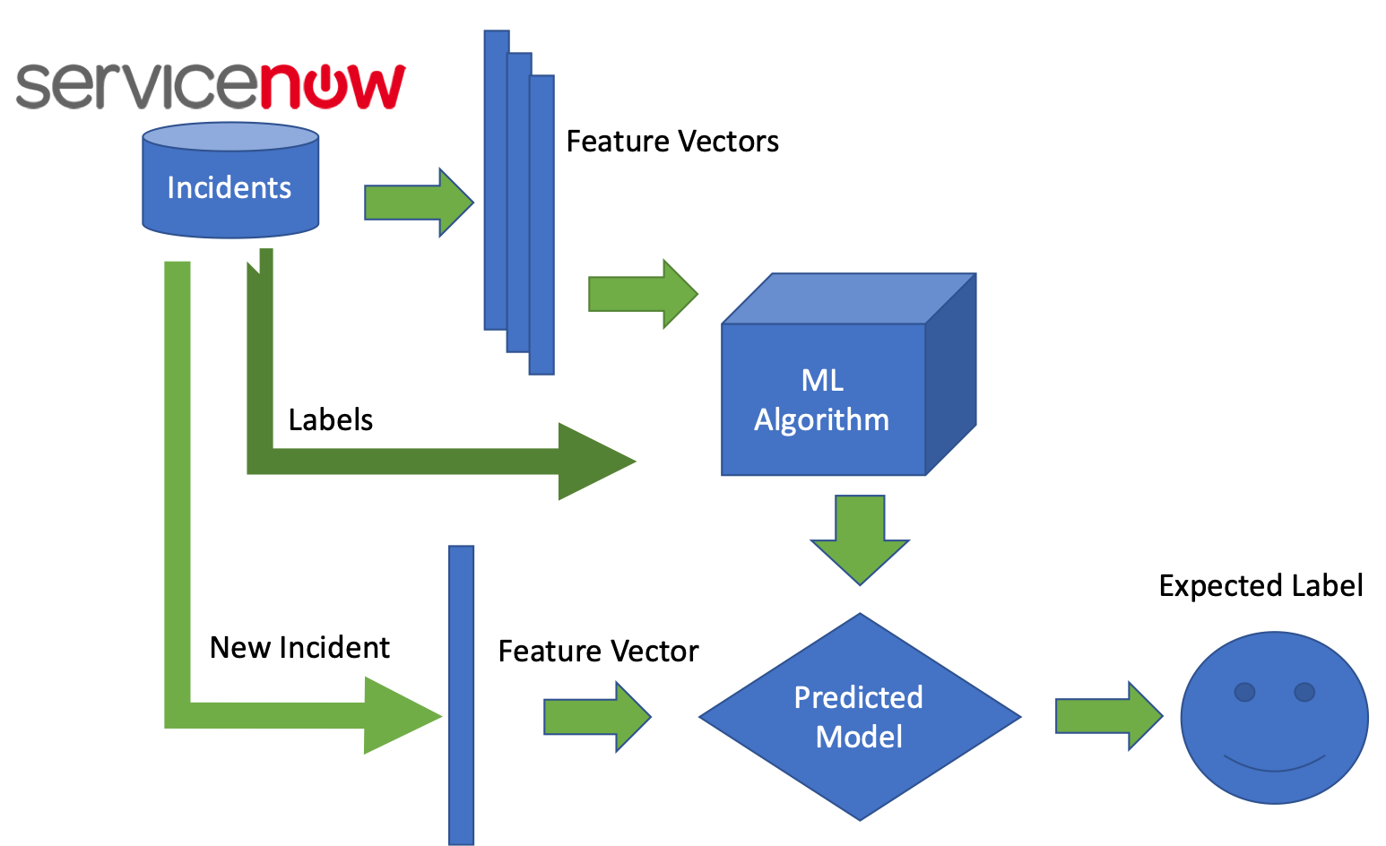
Model creation process
Training text: the ticket description
Training 70% - Testing 30%
Feature Vector containing information describing the characteristics of the input data.
Labels: Predefined categories the model will predict
ML Algorithm: RNN for classification
Creation of the Predictive Model trained using the historical dataset

Slide 8


Data set
56077 observations extracted from ITSM System
Two product lines: Digital and Analytics
Incident description
Sub-Category: 12 Levels
Subsample 63% of the data set = 51872
Resolved by Group: 17 Levels
Subsample 73% of the data set = 41363
Category
Subsample 81% of the data set = 45675
Priority
Subsampling: 80% of the data set= 44990
Resolution Category: 7 Levels
All data - Recategorized
Knowledge Article
52% tickets = 29239

Slide 9
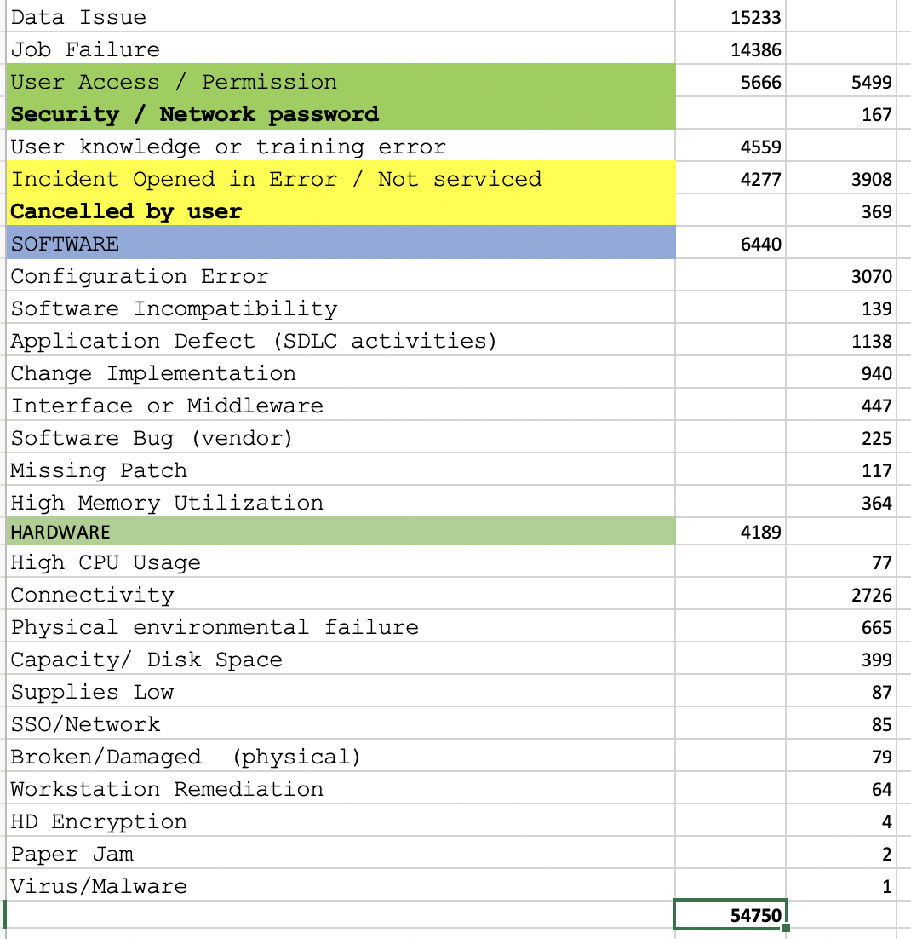
Re-classification of Resolution category

Slide 10
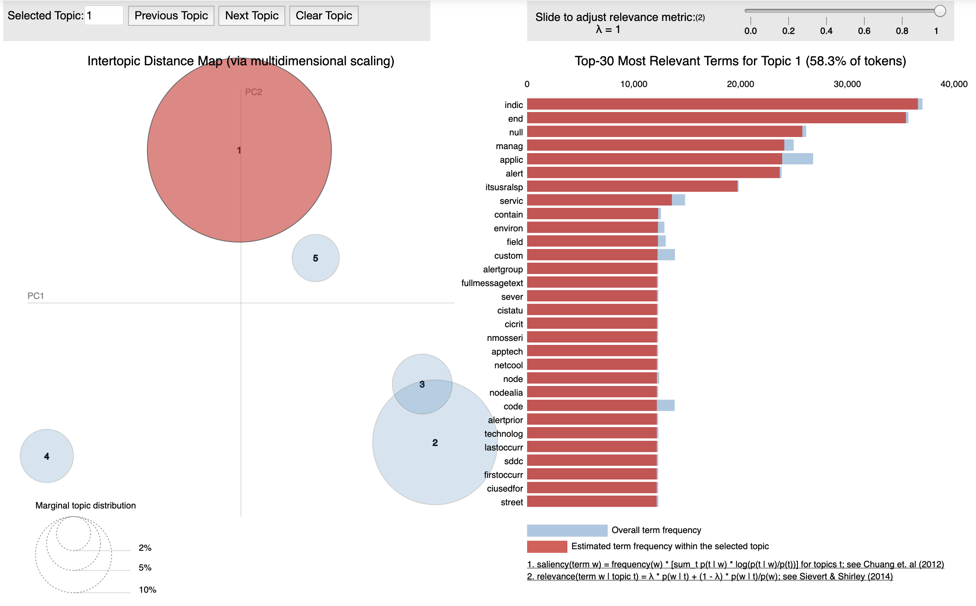
Data preparation and analysis
Removing any NAN observations
Due to special characters created by automatic monitoring systems, we replaced the description with short_description
Subsample data: Removing low freq. categories, and when possible balance the data
7 new Resolution Categories proposed based on the Clustering analysis
Most of the descriptions are less than 20 characters which makes difficult not only for manual but automatic tools to determine correct categories

Slide 11
Results

Slide 12
Results of the Neural Network RNN for Incident Classification
Sub-Category
Accuracy: 74%
Resolved by Group
Accuracy: 80%
Category
Accuracy: 91
Priority
Priority: 84%
Resolution Category: 7 Levels
All data - Recategorized
Knowledge Article
Accuracy: 37%

Slide 13
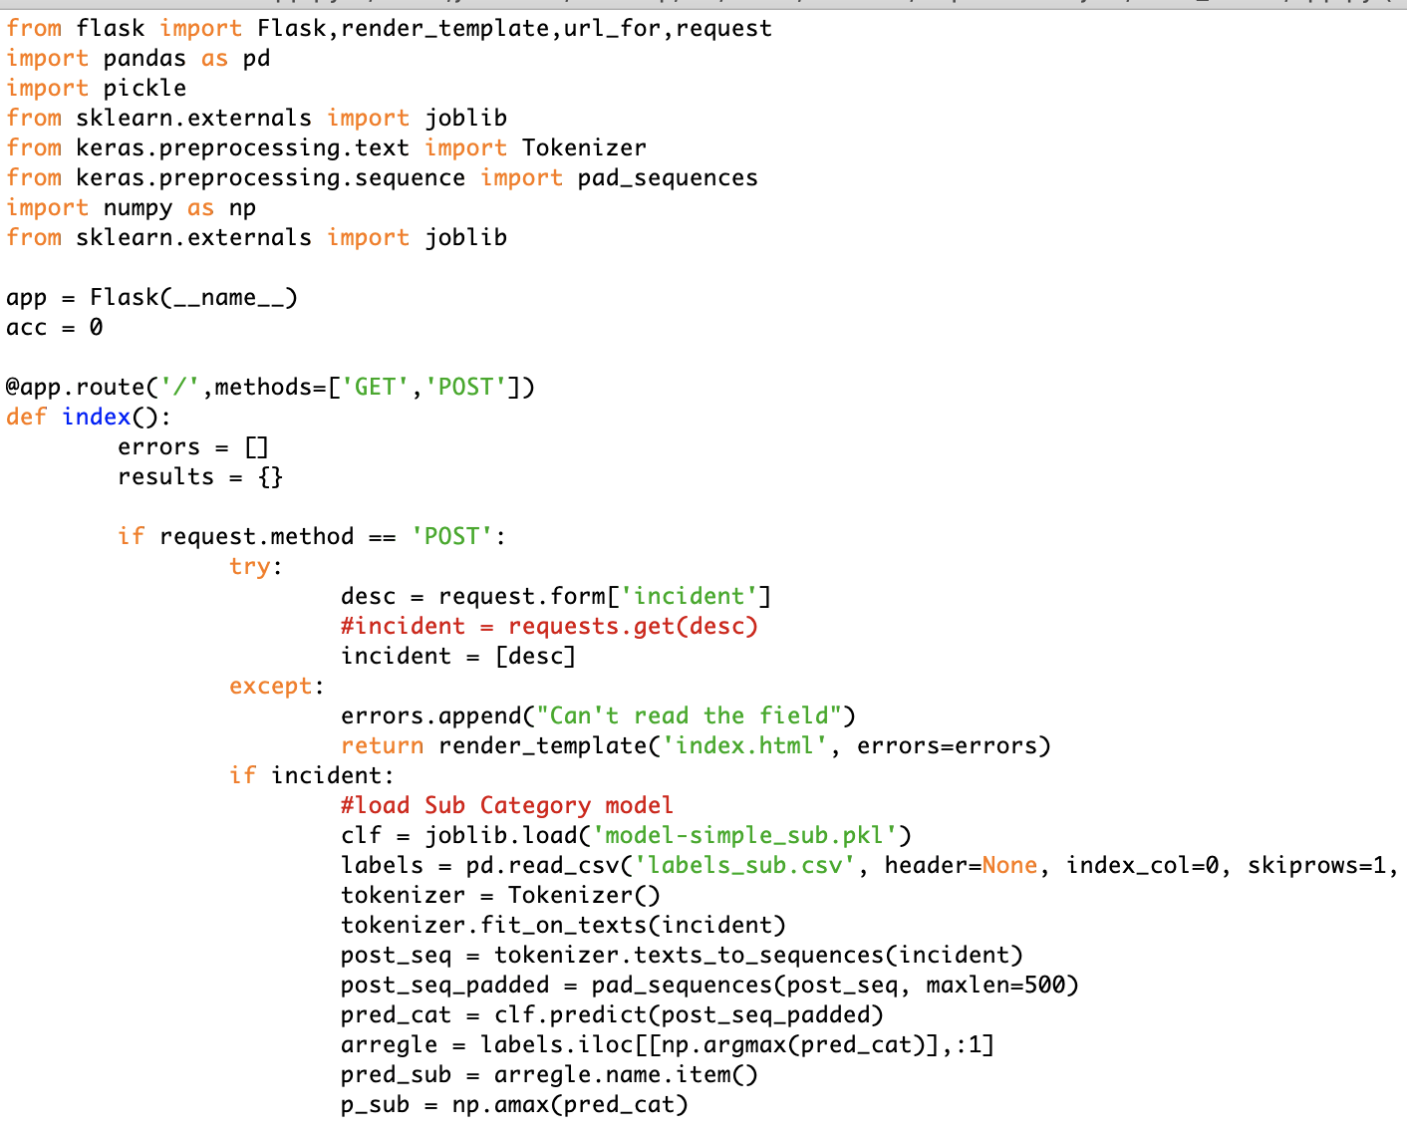
Deployment
Integration between ServiceNow and AWS using the endpoint url triggered by the API Gateway through Rest web services and accessed it using javascript that runs on creation of ticket.
On creation of a ticket, the javascript is triggered which sends the incident description already tokenized/padded to the model placed in AWS which performs the machine learning operations and returns back the predicted categories and probability.
While the results are assessed by ITSM leadership, the model was deployed using Flask where the description is submitted and the model predicts each category with a probability.
Demo
https://github.com/JAIR0MEL0/ML1030-Capstone-Project

Slide 14
Conclusions
The deployment of this model is targeting the reduction of incorrect first time assignment and meantime resolution caused partly by miss routing or miss classification of the tickets which translate into customer satisfaction, better resource allocation and better preventive activities.
First time assignment to improve using a Augmented Reality classification process where Service Desk team will Focus on Tickets classified with less than 80% of accuracy.
ITSM management identified a need to reinforce with the Helpdesk team to improve the descriptions with more relevant information
The usage of the Word count distribution across time and LDA and correlation matrix will be used as metrics by TS Management
Automatic process fill the description with parameters with no relevant data
Resampling the data it reduces the unbalance data but increases the bias. Reclassification of the categories was approved by stakeholders
A general RNN model without LSTM provided us the accuracy of 58% whereas LSTM network layer in RNN didn’t really improve and it could be related to the data.
This represents the first step on the way towards a fully automated, future-proof end-to-end ticket processing pipeline, especially when considering integrating these solutions with chatbot front-ends for automatic ticket data collection at the start of the process and with ML-enabled automatic ticket solution capabilities towards its end. This way, both a truly scalable 24/7 ITSM solution capable of dealing with the ticket volumes looming in the near future can be obtained and IT resources are freed up for more valuable and rewarding activities such as issue resolution and request fulfillment.
Yet 58% was accepted resolution classification as I intend to train it online and continuously improve the accuracy as volume of data grows to higher degree.

